Slide 1


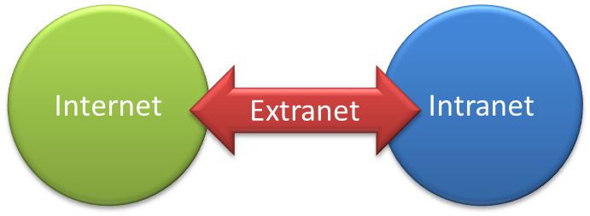
Internet, Intranet and Extranet

Slide 2



What is Internet?
Internet is a Global network of computers which may be server or client that exchanges information.
It can be defined as a "network of networks" which can be linked through copper wires, wireless connections, and other technologies.
This is the world-wide network of computers accessible to anyone who knows their Internet Protocol (IP) address.

Slide 3
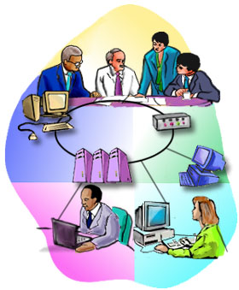
What is Intranet?
The term Intranet is derived from two words: ‘Intra’ which means within and ‘net’ which means group of interconnected computers.
is a private computer network that uses Internet protocols and network connectivity to securely share any part of an organization's information or operational systems with its employees.
In short, an intranet is private network, similar to the Internet and using the same protocols and technology, contained within an enterprise or not-for-profit organization.

Slide 4

How it is different from Internet?
The technologies used in Intranet and Internet may be same but the main difference between them is that the information shared in intranet can be access only by authorized persons especially members or employees of the organization or company where as in internet the information is shared world wide with any public user to explain in simple terms, intranet is private, within the organization while internet is public available for global access requirement. Thus, Intranet is like a private Internet.

Slide 5


Benefits of intranets
Workforce productivity:
Intranets can help users to locate and view information faster and use app. relevant to their roles and responsibilities. With the help of a web browser interface, users can access data held in any database the organization wants to make available, anytime and - subject to security provisions – from anywhere within the company workstations, increasing employees' ability to perform their jobs faster, more accurately, and with confidence that they have the right information. It also helps to improve the services provided to the users.
Time:
With intranets, organizations can make more information available to employees on a "pull" basis (i.e., employees can link to relevant information at a time which suits them) rather than being deluged indiscriminately by emails.

Slide 6

Benefits of intranets
Communication:
Intranets can serve as powerful tools for communication within an organization, vertically and horizontally. From a communications standpoint, intranets are useful to communicate strategic initiatives that have a global reach throughout the organization. The type of information that can easily be conveyed is the purpose of the initiative and what the initiative is aiming to achieve, who is driving the initiative, results achieved to date, and who to speak to for more information. By providing this information on the intranet, staff has the opportunity to keep up-to-date with the strategic focus of the organization.

Slide 7

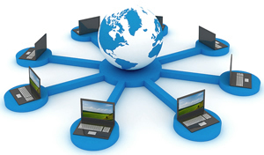
Benefits of intranets
Cost-effective:
Most organizations have already established TCP/IP networks, and the incremental infrastructure cost of adding Web servers to the network is well within even departmental-level budgets. Users can view information and data via web-browser rather than maintaining physical documents such as procedure manuals, internal phone list and requisition forms.
Low maintenance:
With information residing in only one place - the Web server - it is relatively easy and affordable to add new information or to update existing information and make it instantly available.

Slide 8

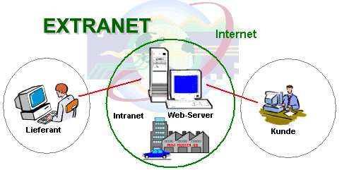
What is Extranet?
It is an intranet for outside authorized users using same internet technologies. The outside users are trusted partners of the organization who have access to information of their interest & concern.
extends the intranet concept to provide a network that connects a company’s network to the networks of its business partners, selected customers, or suppliers.

Slide 9

How it is different from Intranets?
Intranets differ from extranet in that the former are generally restricted to employees of the organization while extranets may also be accessed by customers, suppliers, or other approved parties. Extranets extend a private network onto the Internet with special provisions for access, authorization and authentication.

Slide 10
Types of Extranet
Public Network Extranet
exists when an organization allows the public to access its intranet from any public network. Security is an issue in this configuration, because a public network does not provide any security protection.
Private Network Extranet
Is a private, leased-line connection bet. Two companies that physically connects their intranets to one another. The single advantage of this is Security. The single largest drawback is Cost.

Slide 11
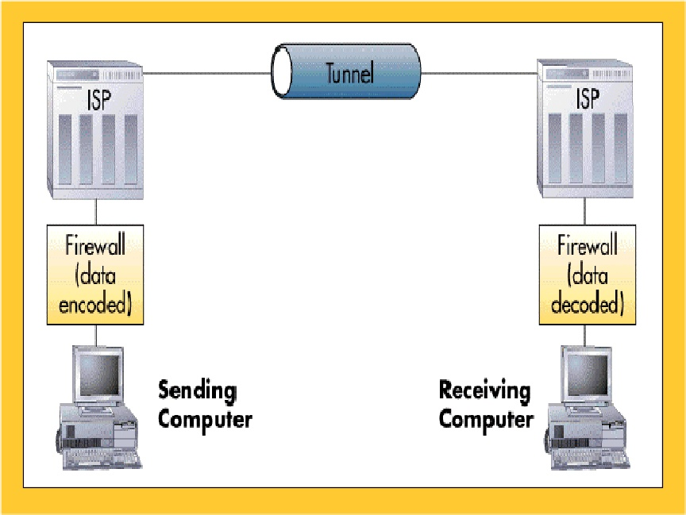
Types of Extranet
Virtual Private Network (VPN)
is a network that uses public networks and their protocols to send sensitive data to partners, customers, suppliers, and employees by using system called “tunneling”. Tunnels are private passage ways through the public internet that provide secure transmission from one extranet partner to another.

